Slide 1

Object Oriented Programming
Principle of LSP
IT560
Sourish Dasgupta
Assistant Professor, DA-IICT, Gandhinagar
https://daiict.ac.in/faculty/sourish-dasgupta

Slide 2
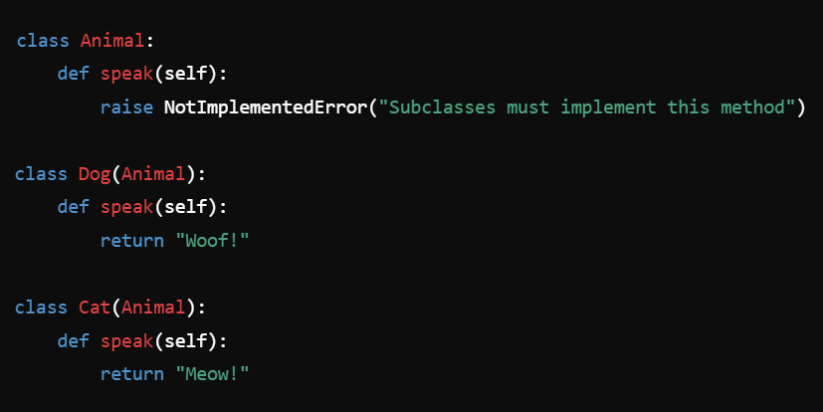


Why the “Base (Abstract) Class” Animal?
Common interface (contract) (speak) that ensures consistency
Enable polymorphism, allowing the client code to work with animals generically
Improve extensibility, making it easy to add new animals
Maintain a clear and organized structure
Adheres to design principles like the Open-Closed Principle (OCP) and Liskov Substitution Principle (LSP)
IT560: Principles of LSP
Sourish Dasgupta

Slide 3
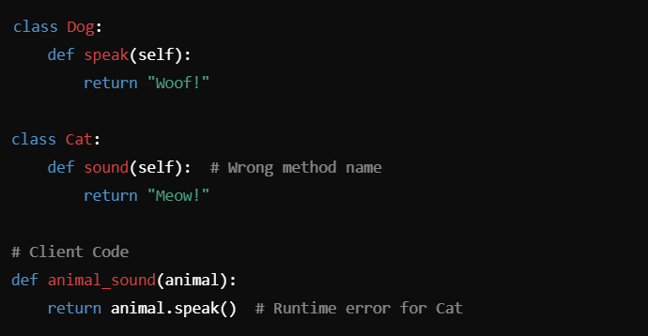
What if we remove Base Class?
Removing the Animal class would lead to a less maintainable, error-prone, and less scalable system
IT560: Principles of LSP
Sourish Dasgupta

Slide 4
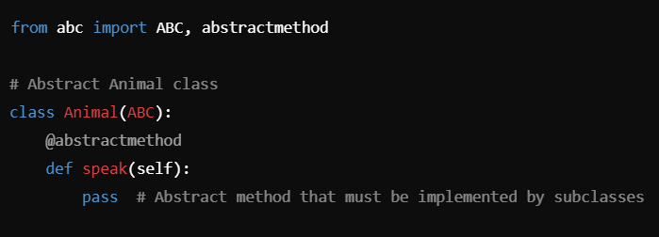
A strictly Abstract Class in Python
IT560: Principles of LSP
Sourish Dasgupta

Slide 5
Liskov Substitution Principle (LSP)
"Objects of a superclass should be replaceable with objects of its subclasses without altering the correctness of the program"
Any instance of a subclass should be able to replace an instance of its superclass without breaking the behavior expected by the client code
Subclasses must fully honor the contract (interface and behavior) defined by the parent class
IT560: Principles of LSP
Sourish Dasgupta

Slide 6
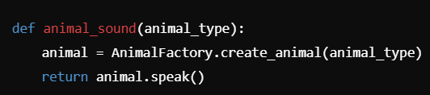
LSP in Action
The client code (animal_sound) interacts with objects through the Animal type.
Doesn’t need to know whether it’s working with a Dog, Cat, or any other subclass of Animal.
As long as each subclass of Animal properly implements the speak method, the client code will work correctly
IT560: Principles of LSP
Sourish Dasgupta

Slide 7
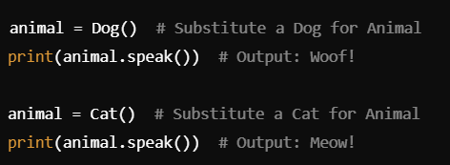
LSP in Action: Substitution w/o Breaking Behavior
A Dog or Cat object can replace an Animal object in the animal_sound function without requiring changes to the function's logic or causing errors
Consistency of the Interface (speak):
The Animal class defines the speak method as a contract.
Every subclass (Dog, Cat) must implement speak with behavior that aligns with the expectations of the client code.
IT560: Principles of LSP
Sourish Dasgupta

Slide 8
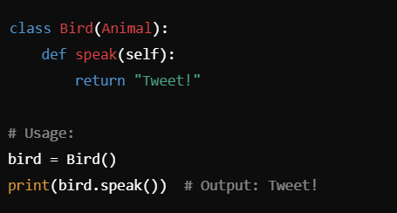
LSP in Action: Extensibility w/o Violation
Adding a new animal (e.g., Bird) still adheres to the LSP
IT560: Principles of LSP
Sourish Dasgupta

Slide 9
What violates LSP?

Slide 10
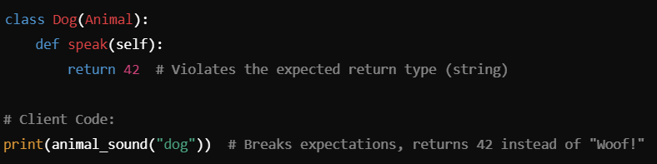
Breaking LSP: Violation of Expectation
IT560: Principles of LSP
Sourish Dasgupta

Slide 11
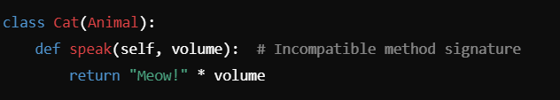
Breaking LSP: Unexpected Modifications
IT560: Principles of LSP
Sourish Dasgupta

Slide 12
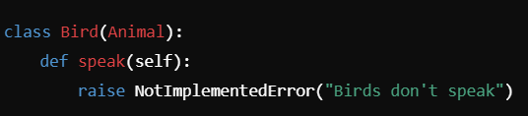
Breaking LSP: Unexpected Exceptions
IT560: Principles of LSP
Sourish Dasgupta

Slide 13
LSP
Ensures Polymorphism Works Correctly:
The client code (animal_sound) can interact with any Animal object without needing to know the exact subclass.
Simplifies the design and allows the system to be extended with new animals seamlessly.
Prevents Fragile Code:
If a subclass violates LSP, client code might break unexpectedly when interacting with that subclass, leading to fragile and hard-to-maintain code.
Supports Open-Closed Principle:
LSP is closely tied to the Open-Closed Principle (OCP).
By ensuring that subclasses respect the contract of the base class, you can add new functionality (new subclasses) without modifying existing client code.
IT560: A Tale of Constructors
Sourish Dasgupta

Slide 14
Can a code obey OCP but violate LSP?

Slide 15
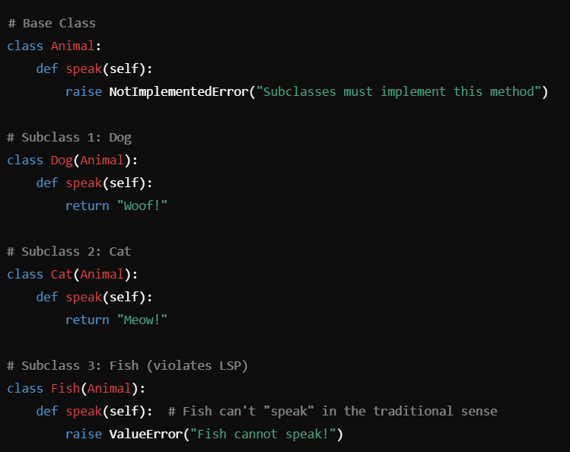
Breaking LSP w/o breaking OCP
IT560: Principles of LSP
Sourish Dasgupta

Slide 16
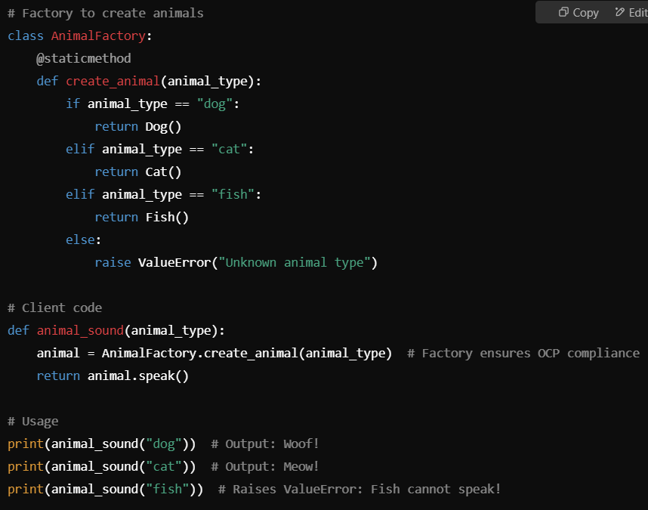
Breaking LSP w/o breaking OCP
IT560: Principles of LSP
Sourish Dasgupta

Slide 17
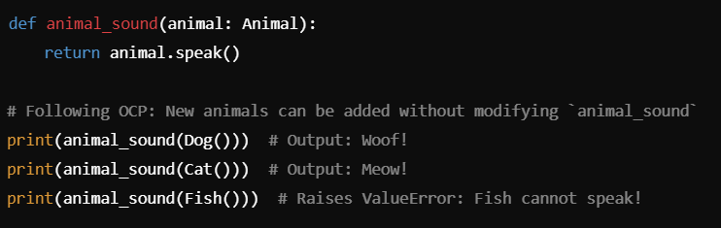
Breaking LSP w/o breaking OCP (no Factory Pattern)
IT560: Principles of LSP
Sourish Dasgupta

Slide 18
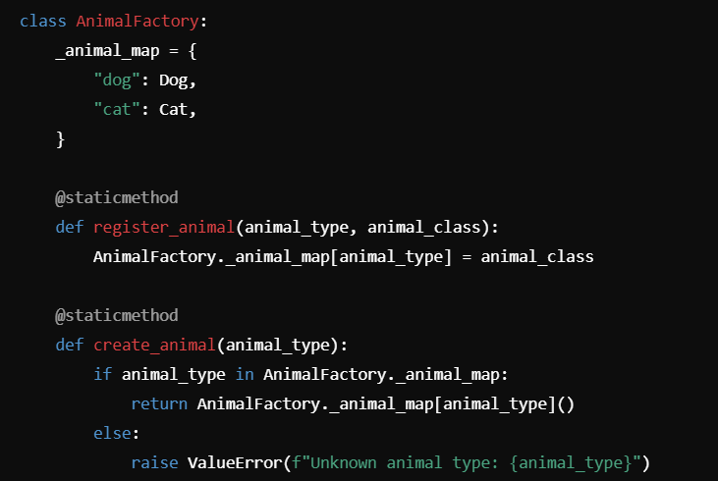
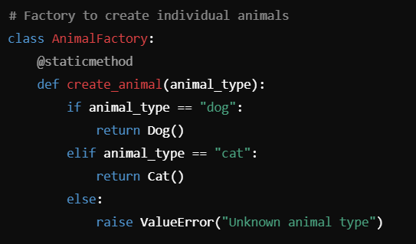
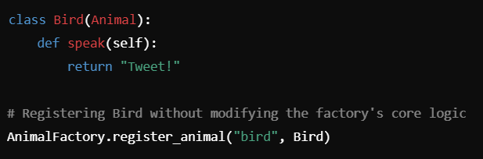
Factory Update with OCP
IT560: Creational Design Patterns
Sourish Dasgupta

